Slide 1



PARKING ZONE
TEAM MEMBERS:
PREMKUMAR.A ROHITH.S SABARIMANIKANDAN.S

Slide 2
Introduction
What is a Parking Zone?
Definition: A designated area where vehicles are allowed to park.
Purpose: To organize parking in urban areas and optimize space usage.
They are typically established to manage traffic flow and ensure accessibility in urban areas.
These zones are crucial for urban planning and traffic management,helping to organize
parking in busy areas and enhance accessibility.

Slide 3
Modern Parking Solutions
Smart Parking Systems
Use of sensors and IoT for real-time parking availability.
Automated Parking Garages
Mechanized systems that store cars automatically.
Mobile Apps
Parking management apps for finding and paying for spots.

Slide 4
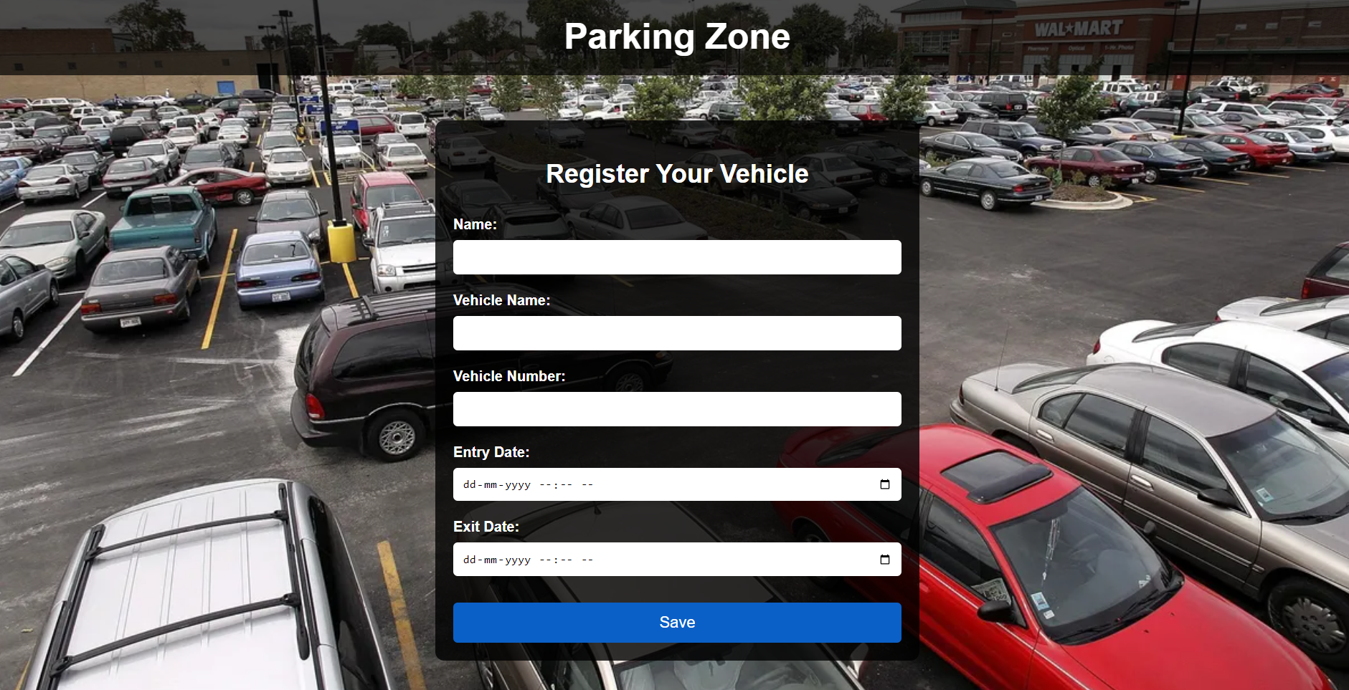

Slide 5
Technology in Parking Zones
License Plate Recognition
For security and monitoring.
Cashless Payment Systems
Payment via apps, RFID, or contactless cards.
Electric Vehicle (EV) Charging Stations
Integration of EV parking with regular zones.

Slide 6
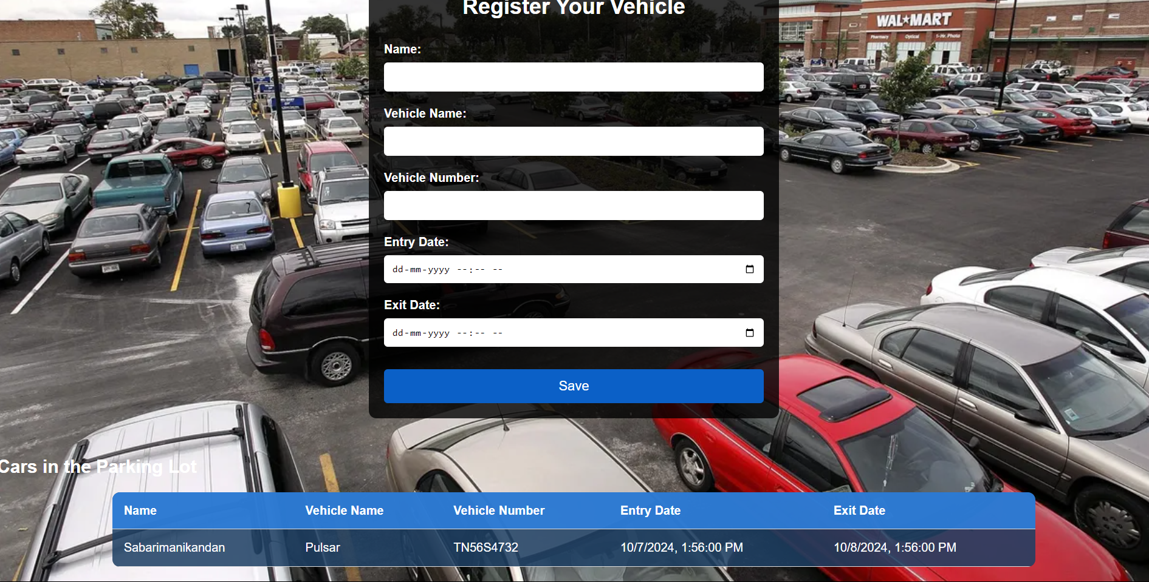

Slide 7
Conclusion
Summary of Key Points
Efficient parking zones benefit urban mobility, reduce traffic, and improve
sustainability.
Future Prospects
The role of AI and further automation in parking management.

Slide 8
THANK YOU

